Slide 1

Department of CSE
(ARTIFICIAL INTELLIGENCE AND MACHINE LEARNING)
ServConnect
AN ANDROID BASED APP FOR SERVICE LENDERS
Under the Supervision
Dr. Sumit Kumar Yadav
Presented By:
Nagaboina Dharsini(ENG22AM0036)
Nitya Shetty (ENG22AM0037)
Sahana Priya G (ENG22AM0050)
Sana Banu (ENG22AM0053)

Slide 2
Overview
Abstract
Problem Statement
Introduction
Social/Environmental Impact
State of the Art work(Literature Review)
Design
Partial Implementation
References

Slide 3
Abstract
A Service - based mobile application.
GPS Technology.
User-friendly booking system.
Through a simple tap, users can request assistance.
The ServConnect app efficiently connects users with service providers , enhancing accessibility to essential services through GPS - based connectivity.

Slide 4
Problem Statement
PROBLEM: Locating and hiring reliable service providers such as plumbers and electricians can be time-consuming and frustrating due to a lack of easy access and limited options.
SOLUTION: Servo Connect simplifies the process by connecting users with qualified service providers based on their location, alleviating the need for extensive research and reducing waiting times.

Slide 5
Introduction
Current Status: The implementation and developing of Servconnect app is still in process
Plan: We aim to refine the app by advanced technology and enhanced user interface.
Scope: This project includes development of the app's features, including refining the GPS-based service provider matching algorithm.
Assumptions: We assume the continuous user interest and engagement with the app, as well as the availability of reliable service providers willing to participate in the platform.

Slide 6
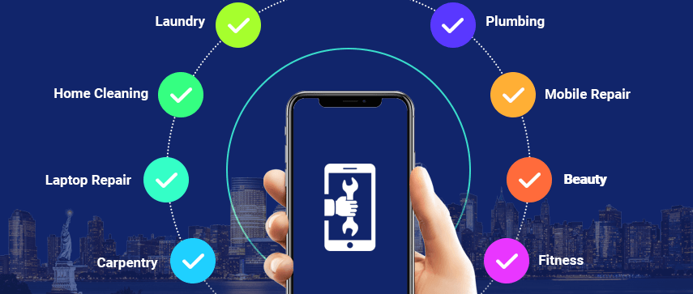
Social/Environmental Impact
The Servo Connect app helps local workers find more jobs, which can help them make more money. Plus, it helps people get services faster, which can mean fewer cars on the road and less pollution.

Slide 7
State of the Art-work
Paper Title and Author Name | Conference Name and year | Technology used | Results | What you infer
An User - Friendly Android based Application for Online Rental System - Dr. B. Dhanalaxmi | Fifth International Conference on I-SMAC -2021 | IoT in Social, Mobile, Analytics and Cloud | Registration module Dashboard module | Android Studio is an Integrated Development Environment (IDE),that supports autocomplete feature and many more useful features which makes it easy to code.
Framework for designing a smart connected product service system - Wei Guo Pingyu Jiang | IEEE 1st International Conference on Digital Twins - 2021 | Product-Service System (PSS) | Designing a smart connected PSS. | Provide service capabilities to meet service demands. Through this "product + service flow" (product and service) integrated solution.

Slide 8
State of the Art-work
Paper Title and Author Name | Conferene Name and year | Technology used | Results | What you infer
A Decentralized Super App - Fernando Kaway Carvalho Ota Cristina G. B. de Oliveira | 24th IEEE International Conference on Mobile Data Management (MDM) - 2023 | super app, which is a mobile app that aggregates various services and products into one platform | retrieving member lists, validating signatures, and token issuance. | security and privacy in super apps and proposes a decentralized architecture to address these concerns
Dept of CSE.(AI&ML), SOE-Dayananda Sagar
University

Slide 9
Design
a. System Overview:
Client-server architecture with mobile app (client-side) and backend server.
Database includes tables for user data, service providers, services, and service requests.
b. Dependencies:
Relies on cloud infrastructure providers.
Integrates with payment gateways, SMS gateway providers, and geocoding/mapping services.
c. Relationships:
Mobile app interacts with backend for authentication, service management, etc.
System features are interconnected for seamless user experience.

Slide 10
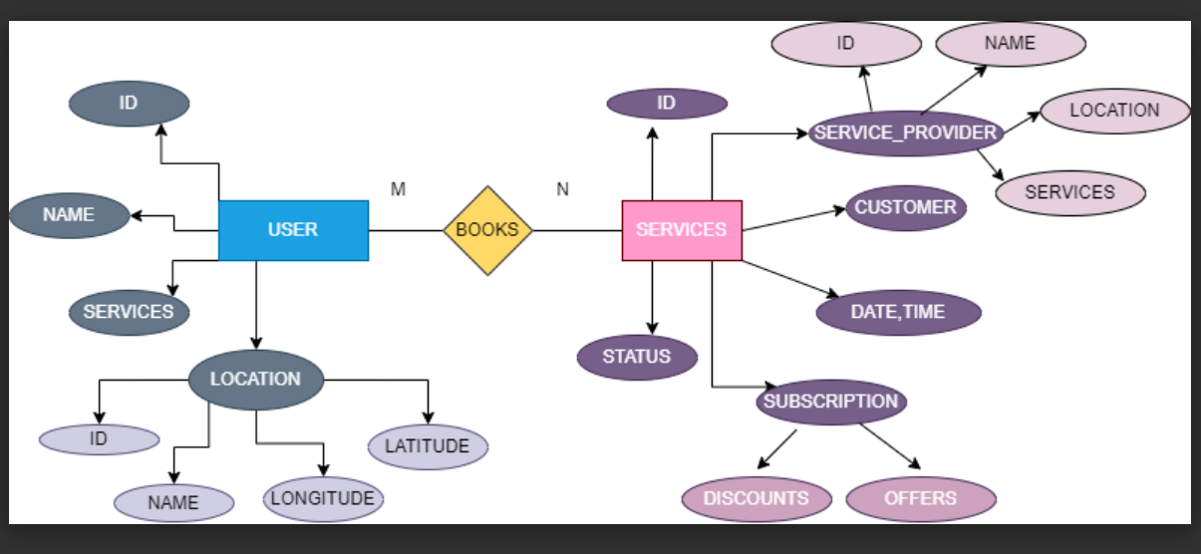
Working of the flow Diagram

Slide 11
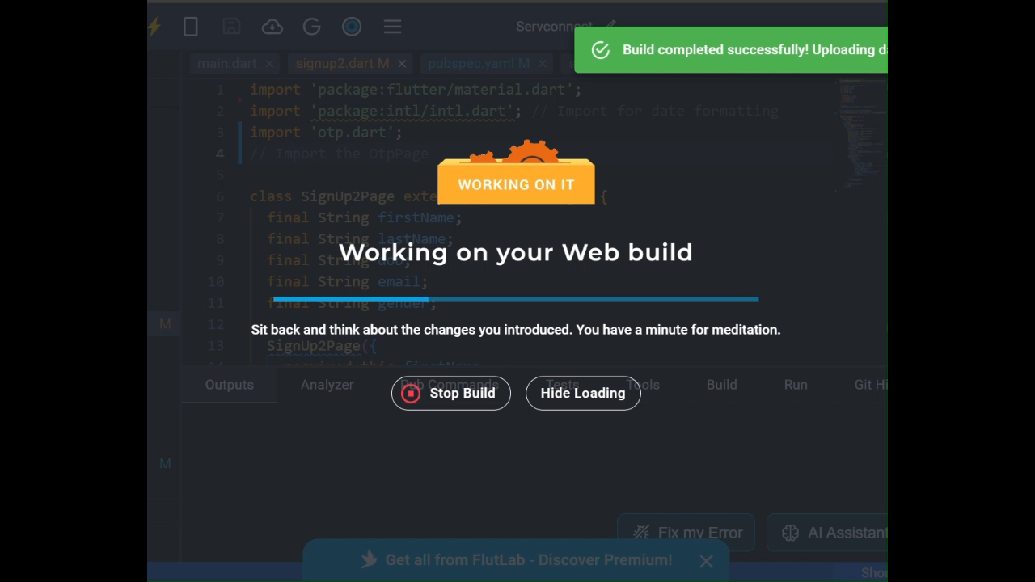
Demonstration

Slide 12
Conclusion
Creating and launching the ServConnect app has been a major step in making it easier to find and hire reliable service providers. This app tackles the common hassles people face by offering a simple and efficient platform. With features like an easy booking system, integrated payment options, and detailed profiles, ServConnect makes connecting with local professionals a breeze. The app's review and rating system also helps build trust.
Beyond convenience for users, ServConnect supports local businesses by giving service providers a platform to reach more customers. By continuously improving based on user feedback, the app stays relevant and useful. Overall, ServConnect shows how technology can make everyday tasks simpler and more efficient for everyone involved.

Slide 13
References
[1] Dr. B. Dhanalaxmi, K. Sainath, B. Saikiran, Sravanthi Varaganti, “An User-Friendly Android Application for Online RentalSystem”, Proceedings of the Fifth International Conference on I-SMAC (IoT in Social, Mobile, Analytics and Cloud) (I-SMAC) IEEE Xplore Part Number: CFP21OSV-ART; ISBN: 978-1-6654-2642-8
[2] Fernando Kaway Carvalho Ota, Cristina G. B. de Oliveira, Rafael Meira Silva, Radu State, “A Decentralized Super App”,2023 24th IEEE International Conference on Mobile Data Management (MDM) 979-8-3503-4101-0/23/$31.00 ©2023 IEEE | DOI: 10.1109/MDM58254.2023.00024
[3] Wei Guo, Pingyu Jiang, “Framework for designing a smart connected product service system “, on Digital Twins and Parallel Intelligence (DTPI) | 978-1-6654-3337-2/21/$31.00 ©2021 IEEE | DOI: 10.1109/DTPI52967.2021.9540186

